Slide 1


SAP UI5 & FIORI with OData TRAINING
Anubhav Oberoy & Shekhar Vedi
Day – 18

Slide 2

Agenda – Day 18
Introduction Fiori App Reference Library
Roles in our Fiori project
Setting up new system
Getting started with a fresh user – Business User
Fiori Security Expert/Fiori Administrator
Configuration v/s Customizing v/s Personalization
Launchpad Content Structure
Semantic Objects

Slide 3

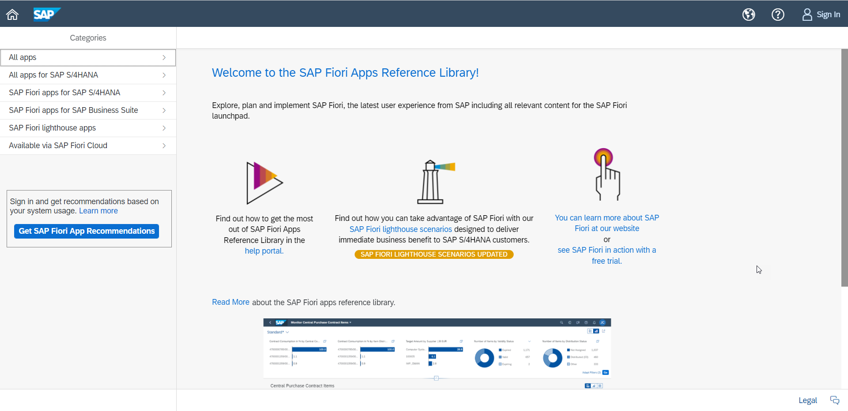
Introduction to Fiori App Referencee Library
Are you implementing SAP Fiori Apps?
Are you looking for information on the current list of apps available and details about configuration and installation?
SAP Fiori apps reference library provides a metadata repository for Fiori apps with information in the areas of installation, configuration, extensibility and support. The list of apps is easily searchable. It also includes filters and grouping based on application component, front end and back-end product versions, application type and other important parameters.
Navigation to help documents and notes makes it more comprehensive. The app provides valuable information to be used right from Portfolio Planning all the way until Customer Go Live. Once the business user selects the required apps in the Innovation Discovery System , the relevant technical information can be readily supplied from the metadata repository.
www.anubhavtrainings.com

Slide 4
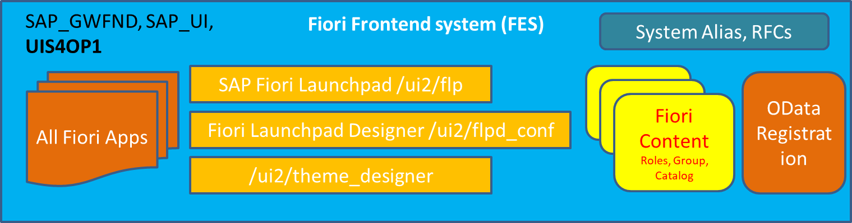
Fiori Architect
Developer personas
SAP Basis Consultants
Arrange the hardware
Plan for system installation
Create Stack.xml and install
Upgrade systems
Download and apply SAP notes
Maintain system health and backup
Overall security and user management
GRC Consultant
SAP Fiori Administrator/ Fiori Security Consultants
Install Fiori Apps
Check and verify if the components are available
Conduct fit-to-standard workshop
Identify Scope
Configure Roles in Fiori system
Manage the deployment of Fiori apps
Run Task lists
Create users who work with Fiori
Create Sample users for testing
Configuring and Adaption of Standard SAP Content
Standard Fiori App activation
Troubleshoot Fiori apps
Configure Custom apps according to need, develop new custom content and roles
Design Launchpad pages
Entire Company theming experience for Fiori
Change login and logout pages
Key Users – Non technical
Little technical knowledge on UI5
Non-coding background
Enhance Fiori apps with minor adaptions which we call key-user extensibility in S/4HANA
Customization changes in SAP system
Configure apps like My Inbox fiori app
Customize Analytic Apps
Use S/4HANA embedded Analytics to develop new type of apps - KPI Tiles
Query Browser
KPI Tiles
OVP
ALP
APF
UI5 Fiori Developers
Setup the development tools like BAS, VS Code
Create Secure connection using Cloud Connector and maintain destinations
Developing custom Fiori Apps – Using Annotations or Free Style
Developing OData Services and Activation of Services
Create Custom apps of different kinds
Troubleshoot apps
Deploy Fiori Apps developed in company to SAP System
Work with SAP BTP to open app on SAP CF
Extensive knowledge on JS and Node JS
Build unit and integration test
Create CI/CD pipelines
Advocate the development team
Create Fiori Prototypes
https://training.sap.com/certification/c_fioad_1909-sap-certified-technology-associate---sap-fiori-system-administration-g/
www.anubhavtrainings.com

Slide 5
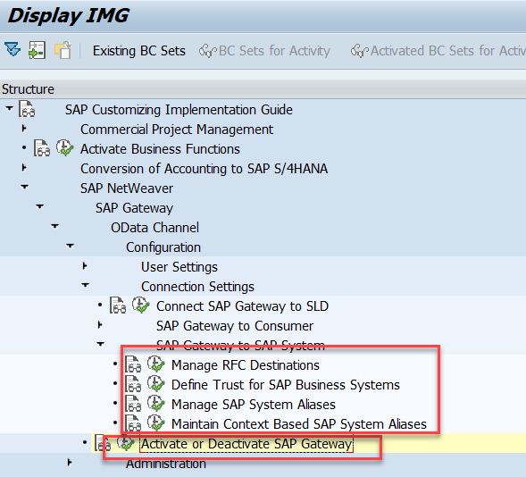
Setting up new system
Anything which runs in browser, needs a service. Getting started with new system
We need to activate SAP Gateway
Create RFC for backend inside the frontend system (SM59) – Type 3
*A self connection is already there – NONE (SAP Delivered default Conn)
Maintain system alias
Any service we activate we need to give the system alias, through which the FES will kno w which backend system it needs to talk to.
When a service gets activated an ICF node gets created, we can check the same in tcode SICF
/n/IWFND/MAINT_SERVICE
https://www.youtube.com/watch?v=wFH52FMJ1nI
www.anubhavtrainings.com

Slide 6

Getting started with a fresh user – Business User
Create a new user ALEX in tcode SU01
When Alex login with the his user, Alex wont be able to access launchpad. /n/UI2/FLP
Once alex open launchpad, he wont be able to see any tile, infect he will see an error
Since it’s a fresh system the Fiori Related Service wont be active so we will register them first
Alex will have further issues accessing the service because of authorization, Create a role which we will grant access to alex.
Any Service has 2 parts, 1. metadata IWSV 2. content IWSG, We need to grant access of /UI2/INTEROP and /UI2/PAGE_BUILDER_PERS
Allow visibility of tile /UI2/CHIP and S_PB_CHIP, these 2 authorization objects must also be assigned to the user through role.
Alex
Sales Representative
SAP make our life Simple –
A existing Template role which is having all the required information related to access of launchpad. – SAP_UI2_USER_700
Make a copy
Add the necessary IWSG for INTEROP and PAGE_BUILDER_PERS service
Create profile
Assign to the user and test using that user
Users should have as minimal as possible authorizations to perform their job
www.anubhavtrainings.com

Slide 7

Fiori Security Expert/Fiori Administrator
In order to enable our SAP Security consultant to access fiori launchpad designer, we need following authorizations
Transaction code /n/UI2/FLPD_CONF and /n/UI2/FLPD_CUST
URL is https://hostname:port/sap/bc/ui5_ui5/sap/arsrvc_upb_admn/main.html?scope=CONF&sap-client=800&sap-language=EN
Following are the list of OData services required to access Fiori launchpad designer and its features
/UI2/PAGE_BUILDER_CONF – loads all the available content from configuration layer
/UI2/PAGE_BUILDER_CUST – loads all the available content from customizing layer
/UI2/TRANSPORT – Used by the launchpad designer to read transports from ABAP system so when we design content in the launchpad designer, it can be transported to the Q and P System
Insert following authorizations using auth template
/IWFND/RT_ADMIN
/IWBEB/RT_BEP_ADM
/IWBEP/ET_MGW_ADM
/IWNGW/RT_WF_ADM
/IWFND/RT_DEVELOPER
SAP Provides a template role for Administrators which you can use to speed up your Admin role Creation
SAP_UI2_ADMIN_700
Kim (BUSER)
Fiori Security Expert
www.anubhavtrainings.com

Slide 8
Configuration v/s Customizing v/s Personalization
Personalization
User specific settings like color theme, settings, Variants, Settings in table only affect the user who did it. This is takes highest priority over the other settings. E.g. Themes in gmail.
Only single user.
Customizing
/ui2/flpd_cust
Customizing Request
Settings which is applicable for All users belonging to a particular client. Customizing’s are always client specific. So suppose we want to give access to a set of users an extra set of tiles in system, then we can use LPD designer in that client with CUST mode.
Configuration
/ui2/flpd_conf
Workbench Type of request
Settings which are applied at entire system level irrespective of Client. If we create a tile in Fiori launchpad designer in CONF mode, this tile will be visible to everyone in the system. We should ideally use always the CONF layer for the tile.
500 users – if I change configurations?
Client 100 – 300 users
Client 200 – 200 users
www.anubhavtrainings.com

Slide 9
Launchpad Content Structure
Fiori Security (Me)
Business User
(Alex)
1
1..*
*..1
SAP Fiori Launchpad Content
*
Fiori Launchpad (/UI2/FLP)
1
Catalog
Role
(PFCG)
GROUP TITLE
Catalog
*
Catalog
1
Fiori Launchpad Designer
(/ui2/flpd_conf)
*
GROUP TITLE
*
Tile
Group
Tile
Group
1
Tile
Group
*
1..1
GROUP TITLE
Target Mapping
*
Target Mapping
Target Mapping
(intents)
WebIDE or BAS
SEGW, CDS
Application
1..1
OData Service
Application
OData Service
1..*
1..*
S_DEVELOP, S_RFC, S_SERVICE

Slide 10
Semantic Objects
Every fiori app which launched from launchpad will follow intent-based navigation. It tells the user about the purpose, why this app is used for. Intent is composed of
Semantic Object + action = Intent
All the SAP delivered standard semantic object are stored in a tcode
/UI2/SEMOBJ_SAP
All the custom semantic objects are created in tcode
/UI2/SEMOBJ
Target Mapping
Is done in fiori launchpad designer to identify which intent will navigate to which fiori app. Every fiori app is deployed in SAP system as BSP app and has a ICF node created. Using target mapping we can map a Ui5 app or classical apps like Webdynpro, GUI etc.
www.anubhavtrainings.com

Slide 11

End of Day 18

Slide 12

Questions

Slide 13

Anubhav Oberoy

Slide 14


We’re committed to empower you to be
Most Desirable Resource
through powerful training solutions.
We build the workforce of the future.
250+
Corporate Clients
30,000+
Learners Trained
25000+
Learners Placed
FREE WEBINARS
Sign up for free webinars with industry experts every fortnight!
Enroll Now!
Contact us today!
https://anubhavtrainings.com/

Slide 15




More from AnubhavTrainings.com

Slide 16
Title
Content

